Slide 1
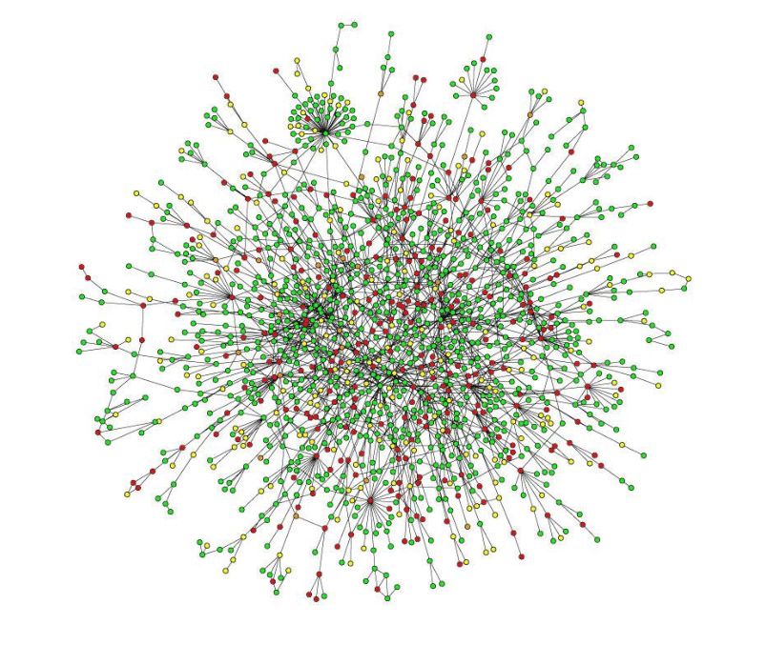

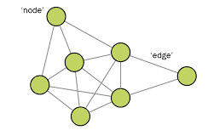
Networks and Spectral Graph Theory
CASE STUDY
Notes:
ID=d924773e-9a16-4d6d-9803-8cb819e99682 Recipe=text_billboard Type=TextOnly Variant=0 FamilyID=AccentBoxWalbaum_Zero

Slide 2
Introduction
Proteins have specific jobs or functions inside the cell, such as controlling chemical reactions, transmitting signals, and building structures. But many times, these jobs are too big or complex for a single protein to handle alone. That's when protein-protein interactions come into play.
In yeast, protein-protein interactions are essential for many cellular processes to work properly. They help with tasks like converting food into energy, repairing damaged DNA, regulating gene expression, and carrying molecules to the right places within the cell.

Slide 3
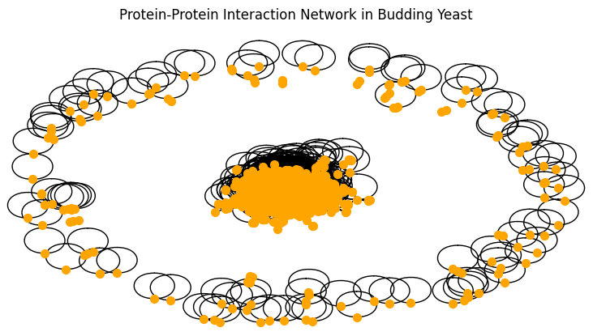
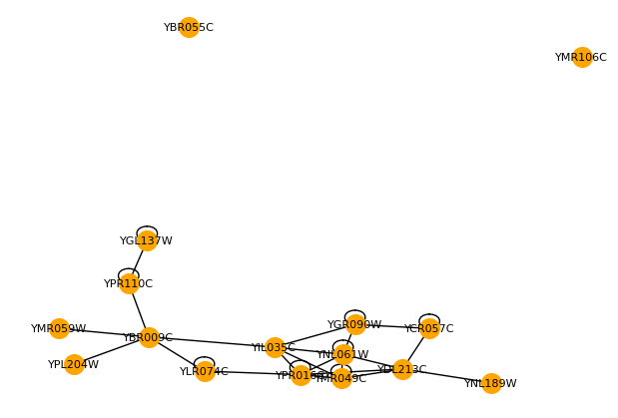

Dataset
Dataset : Protein-Protein Interaction Network in budding Yeast
http://vlado.fmf.uni-lj.si/pub/networks/data/bio/Yeast/Yeast.htm
Number of Vertices : 2367
Number of Edges : 7186
Number of self loops : 536

Slide 4
Queries
Degree Centrality
Identity the most connected protein in the network
Clustering Coefficient
Determine how likely 2 proteins interact with each other
Shortest Path
Find Shortest path between 2 protein
Connected Component
Identify a group of protein that are directly or indirectly connected to each other
Betweenness Centrality
Discover the protein that act as a critical mediator or bridge between different protein groups

Slide 5
Page Rank Algorithm
PageRank is an algorithm used to measure the importance or centrality of web pages in a network, particularly in the context of web search and ranking.
The underlying principle of PageRank is that a page's importance is determined by the number and quality of other pages linking to it.
The equation for calculating PageRank is as follows:
PR(A) = (1 - d) /N + d * (PR(T1)/C(T1) + PR(T2)/C(T2) + ... + PR(Tn)/C(Tn))
In the context of protein-protein interaction networks, PageRank can help identify proteins
that have a higher importance or influence within the network. These proteins may serve
as key connectors, linking different functional modules or pathways, or they may play
critical roles in the overall structure and dynamics of the network.

Slide 6
Thankyou

